Slide 1
Object Detection in Point Cloud: Pole
--Venkata Sivanaga Saisuvarna Krishna Manikeswaram Chaitanya (A20360206)
--Sowjanya Mallu (A2038554)
-Roshni Masand (A20355488)
-Chaitanya Sistla(A20373561)

Slide 2
Language and Packages Used
Language: Python 2.7
Package:
Pcl
Matplotlib
Numpy

Slide 3
Goal
Input:
The input data is provided in the format:
latitude, longitude, altitude, intensity
Detect poles in the given data
Output:
The detected poles in 3d plot

Slide 4
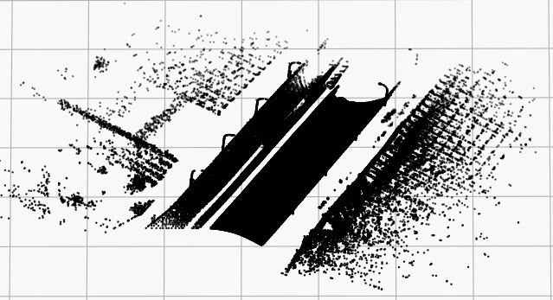
Original Image

Slide 5
Step 1: Convert the points and Filter Outliers
Convert the given data into x, y, z co-ordinates. Where x is latitude, y is longitude and z is altitude.
We then remove outliers from the original dataset. It means that all the points in the dataset which are away from the threshold are removed.
To do this we use Statistical Outlier Filter from PCL.
Extract the outlier points and return the remaining points
Notes:
Outliers-relevant data
Removing outliers smooths out the original dataset
http://pointclouds.org/documentation/tutorials/statistical_outlier.php
1

Slide 6
Statistical Outlier Filter
Method used: pcl.make_statistical_outlier_filter
For each point, compute mean distance from it to all it’s neighbours.
Assuming that the resulting distribution is Gaussian with a mean and standard deviation,
All points whose mean distances are outside the interval defined 2 parameters, are considered outliers;
We take k=50 and standard deviation=5
Notes:
Use K-Nearest Neighbours, where
K=50,
K → the number of points analysed.
Standard Deviation Threshold :5
Points which have larger than 5 standard deviation of the mean distance to the query point will be marked as outliers and removed.
1

Slide 7
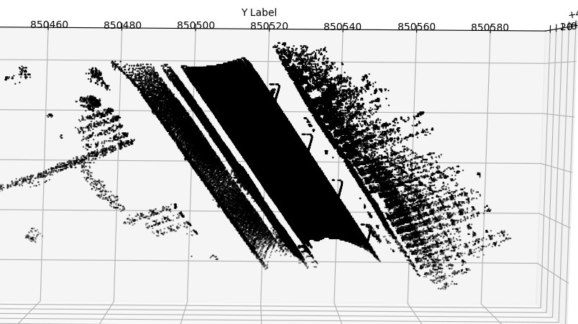
After removing Outliers

Slide 8
Step 2: Remove largely connected components
This step is performed to remove elements like buildings, cars, points on the road or extra points like those of hills. As our data set is having cars which are obstructing the poles.
This is done using KDTree.
Notes:
if summed squared distance < 5000, removed this component
■ Assessed density: only removed large chunks of data that were closely linked
1

Slide 9
KD Tree
Methods used: make_kdtree_flann() and nearest_k_search_for_cloud()
nearest_k_search_for_cloud() : According to the parameter input, this method finds 1000 closest points and their squared distance.

Slide 10
Step 3: Segmentation
We performed Cylindrical and Plane Segmentation on the obtained results from the previous steps.
We used the class pcl. Segmentation where in we used SACMODEL_CYLINDER and SACMODEL_PLANE
The method used was SAC_RANSAC
Certain thresholds were set to obtain results.
Notes:
“Extract connected components with area under a threshold to find small objects. This
method is effective at finding isolated poles, but performs worse for cars and objects
amongst clutter.”
● SACModel = cylinder
○ Segment for points that were in a cylinder with radius between bounds 0 and 10.
○ Distance threshold between points was 20
○ Our goal was to segment out cylindrical objects and discard all other points
● Weakness: long part of the pole is a cylinder, but the top is not
● Radius : Had to increase radius to account for top part of lamp pole, but this
allowed other points to come in
Like we did in cylindrical segmentation, similarly here we segment the ground plane and discard the indices associated with the plane.
The details of this Segmentation are as follows:
Model type is SACMODEL_PLANE
Method type is SAC_RANSAC
Distance Threshold is 85
<number>

Slide 11
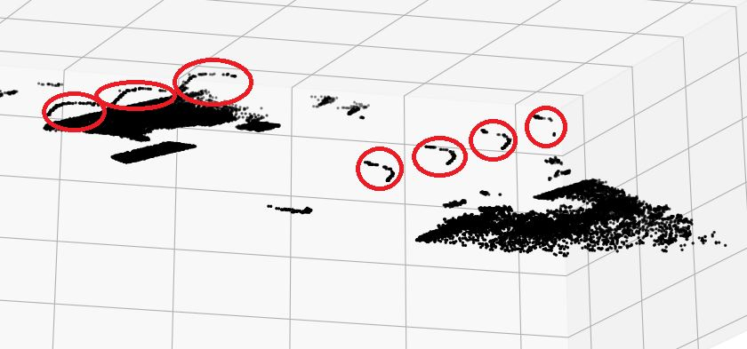
Final Output

